Slide 1
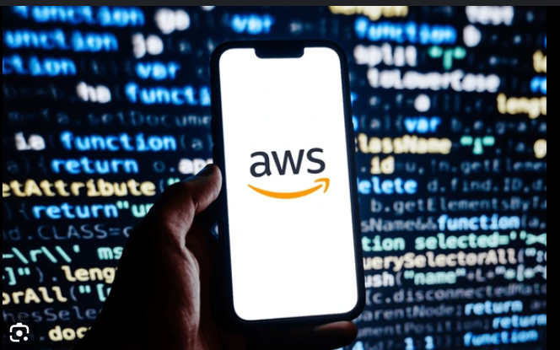

AWS Development
UDAY SAI SIDDARDHA
20-2-2025

Slide 2
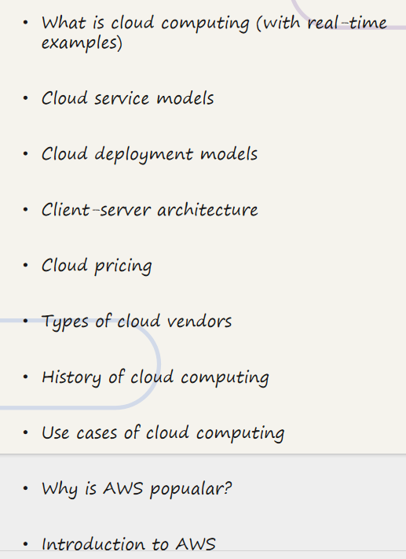

TOPICS ---------->

Slide 3

What is Cloud Computing?
Cloud computing is on-demand access to computing resources. Servers, storage, and databases are available over the Internet. Examples include streaming services like Netflix. Also consider file storage like Google Drive. Cloud gaming services like GeForce Now are examples too.
Scalability
Cost-Effective
Easily scale resources up or down as needed.
Pay only for the resources you consume.

Slide 4

AWS Development Definition:
AWS Development involves building, deploying, and managing applications using Amazon Web Services (AWS). It includes working with AWS services like EC2 (Compute), S3 (Storage), Lambda (Serverless), RDS (Databases), and API Gateway to create scalable, secure, and efficient cloud-based applications.
Cloud Computing Real-Time Examples:
Google Drive & Dropbox → Cloud-based storage.
Netflix & YouTube → Streaming services hosted on the cloud.
Zoom & Google Meet → Cloud-based video conferencing.
Online Banking Apps → Secure transactions stored in the cloud.
E-commerce (Amazon, Flipkart) → Cloud-hosted product catalogs & payment processing.
AI Assistants (Alexa, Google Assistant) → Cloud-powered AI models.
Gaming (PUBG, Fortnite) → Cloud-based multiplayer servers.

Slide 5
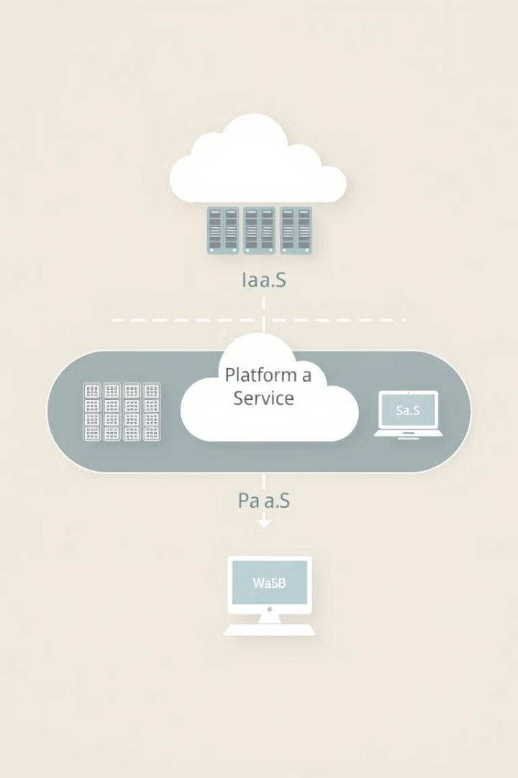
Cloud Service Models
Cloud computing offers three primary service models. IaaS (Infrastructure as a Service) provides virtualized computing resources. PaaS (Platform as a Service) provides a platform for developing and deploying applications. SaaS (Software as a Service) delivers software applications over the Internet.
1
IaaS
2
PaaS
Gives you the most control over your infrastructure.
Offers a complete development and deployment environment.
3
SaaS
Provides ready-to-use software applications.

Slide 6
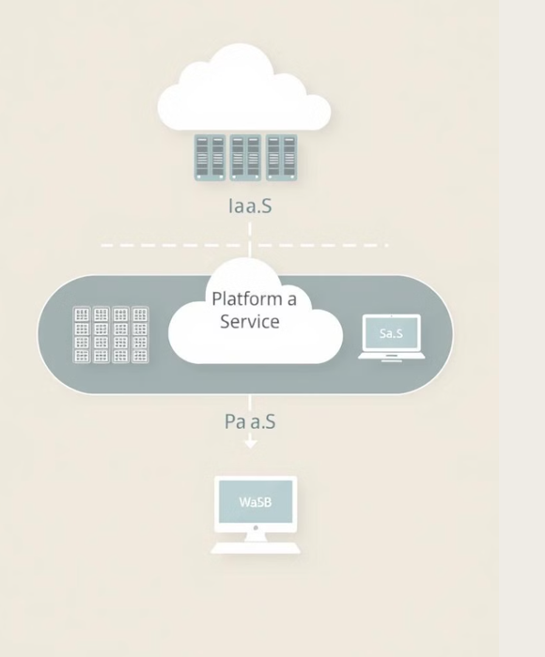
IaaS (Infrastructure as a Service) – "Virtual Hardware"
Provides virtualized computing resources like servers, storage, and networking. Example: AWS EC2, Google Compute Engine, Microsoft Azure VMs
PaaS (Platform as a Service) – "Development Platform"
Offers a managed environment for developers to build and deploy applications without managing infrastructure. Example: AWS Elastic Beanstalk, Google App Engine, Heroku
SaaS (Software as a Service) – "Ready-to-Use Software"
Delivers fully functional applications over the internet, requiring no installation or maintenance. Example: Gmail, Microsoft 365, Dropbox, Zoom

Slide 7
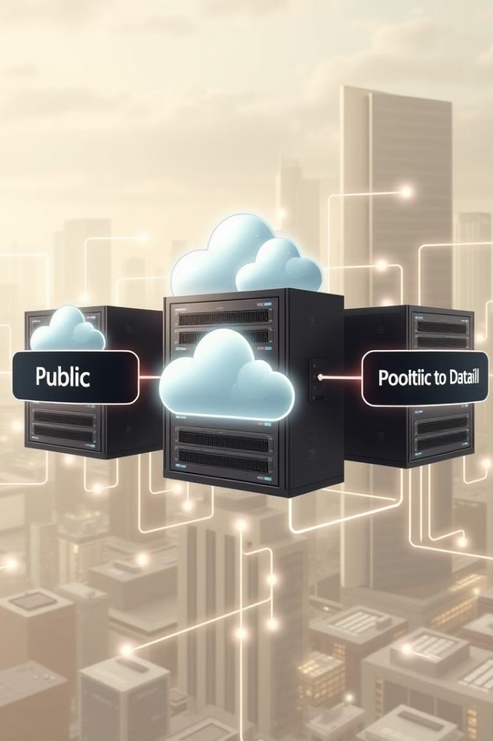



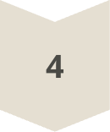
Cloud Deployment Models
Cloud deployment models define where the cloud infrastructure is located. Public clouds are owned and operated by third-party providers. Private clouds are dedicated to a single organization. Hybrid clouds combine public and private clouds. Community clouds are shared by several organizations.
Public Cloud
Private Cloud
Hybrid Cloud
Community Cloud

Slide 8



Client-Server Architecture
Client-Server Architecture
It is a model where a client (user's device) requests services, and a server (powerful computer) processes and responds.
Example:
Google Search → Your browser (client) sends a request to Google’s server, which processes it and returns search results.
Netflix Streaming → Your device (client) requests a movie, and Netflix’s server delivers the video.
2
Server Processing
1
Client Request
Server Response
3

Slide 9
IaaS (Infrastructure as a Service) – "Virtual Hardware"
ProvideIs virtualized computing resources like servers, storage, and networking. Example: AWS EC2, Google Compute Engine, Microsoft Azure VMs
PaaS (Platform as a Service) – "Development Platform"
Offers a managed environment for developers to build and deploy applications without managing infrastructure. Example: AWS Elastic Beanstalk, Google App Engine, Heroku
SaaS (Software as a Service) – "Ready-to-Use Software"
Delivers fully functional applications over the internet, requiring no installation or maintenance. Example: Gmail, Microsoft 365, Dropbox, Zoom

Slide 10
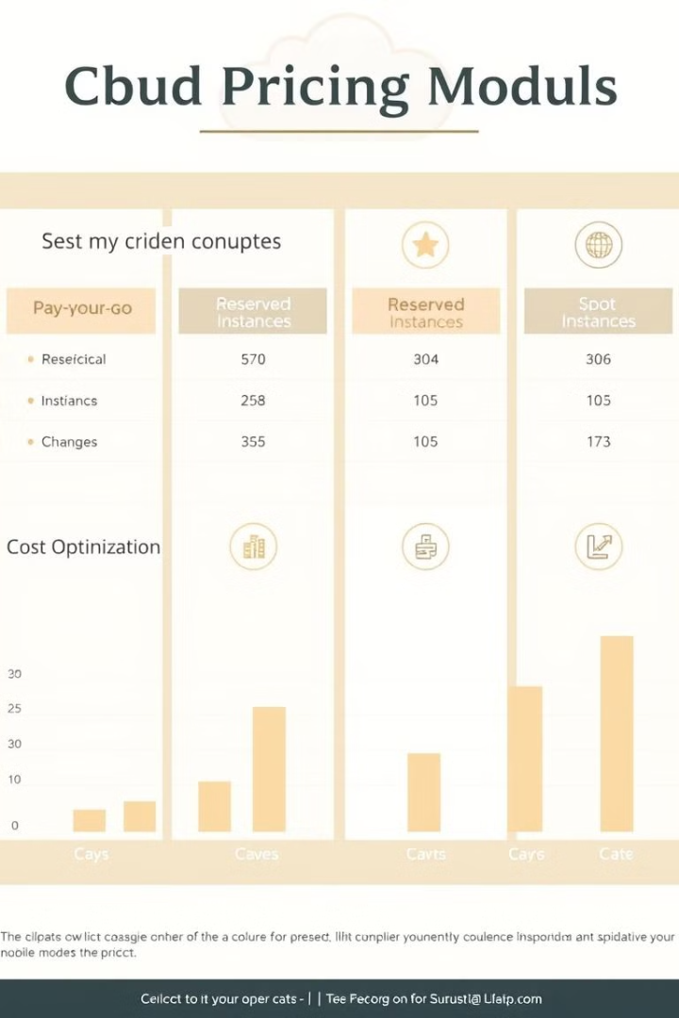
Understanding Cloud Pricing
Cloud pricing is typically pay-as-you-go. You only pay for the resources you consume. Some providers offer reserved instances for discounted rates. Other options include spot instances for bidding on unused capacity. Understanding pricing models is key to cost optimization.
$0.01
$0.10
Per GB
Per Hour
Storage Costs
Compute Costs
$1.00
Per Month
Base Costs

Slide 11
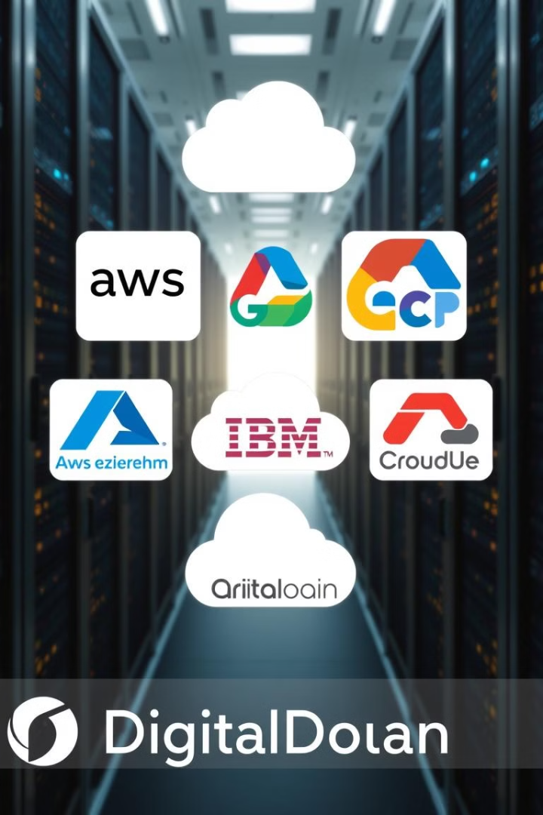



A Look at Cloud Vendors
Amazon Web Services (AWS) is a leading cloud provider. Microsoft Azure is another major player in the cloud market. Google Cloud Platform (GCP) offers a range of cloud services. Other vendors include IBM Cloud, Oracle Cloud, and DigitalOcean.
AWS
Azure
GCP
Market leader with a wide range of services.
Strong integration with Microsoft products.
Known for its data analytics and AI capabilities.

Slide 12
Cloud Vendors
1.Public Cloud Providers
Offer cloud services over the internet to multiple users.
Examples: AWS, Microsoft Azure, Google Cloud Platform (GCP), IBM Cloud
2. Private Cloud Providers
Provide cloud infrastructure dedicated to a single organization.
Examples: VMware Cloud, OpenStack, Dell EMC Cloud
3. Hybrid Cloud Providers
Offer solutions that integrate both public and private cloud environments.
Examples: AWS Hybrid Cloud, Microsoft Azure Hybrid, Google Anthos

Slide 13
The AWS Edge
AWS offers a comprehensive set of cloud services. It has a large and mature ecosystem. AWS has a global infrastructure and a strong focus on security. Their vast services and mature marketplace give them an edge. AWS provides a wide array of compute, storage, and database options.
1
Global Scale
2
Security Focus
3
Mature Ecosystem

Slide 14
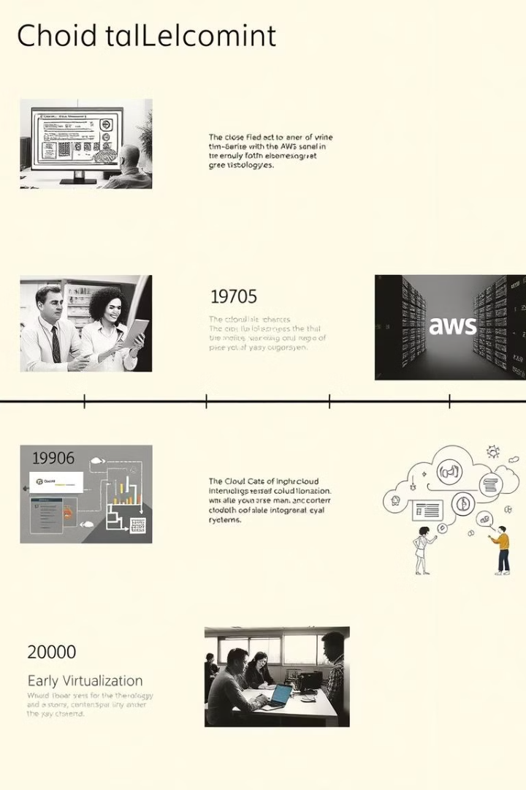
History of Cloud Computing
The history of cloud computing spans decades. Time-sharing in the 1960s was an early precursor. Virtualization emerged in the 1990s. AWS launched in 2002, marking the beginning of modern cloud computing. Now cloud is mainstream and here to stay.
1
1960s
Time-Sharing
2
1990s
Virtualization
3
2002
AWS Launch

Slide 15
Key Features of AWS
Scalability: Easily scale resources up or down based on demand.
Flexibility: Supports a wide range of operating systems, programming languages, and frameworks.
Cost-Effective: Pay-as-you-go pricing model with no upfront costs.
Reliability: High availability and fault-tolerant infrastructure.
Security: Robust security measures, including encryption, identity management, and compliance certifications.

Slide 16

Use Cases of Cloud Computing
Data Storage & Backup – Storing large amounts of data securely with automatic backups and easy retrieval (e.g., AWS S3, Google Drive, Dropbox).
Gaming – Running online multiplayer games with high performance and scalability (e.g., AWS GameLift, Google Stadia).
Web Hosting
Big Data
Disaster Recovery

Slide 17
